Slide 1
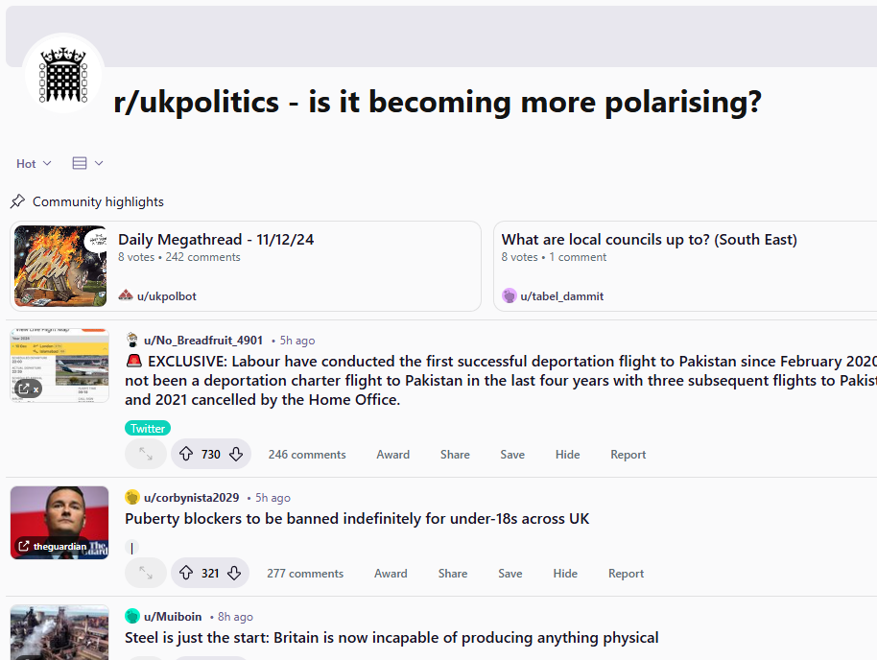

Data Science - Group 7
AIMEE CARTER
BEE DENLEY-CURRIE
EMILY BAYLISS
THEA RALPH
ELINOR GREENHOUSE
PAIGE KOCKELBERGH

Slide 2
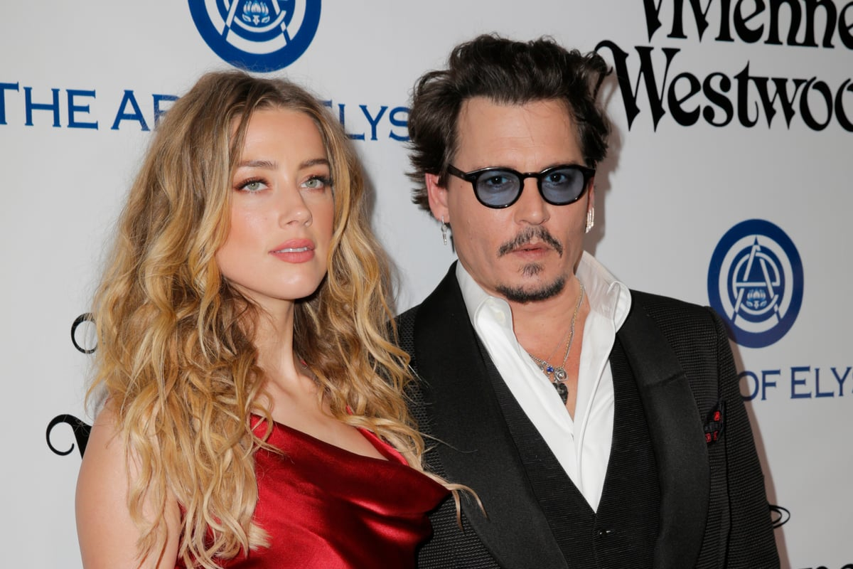


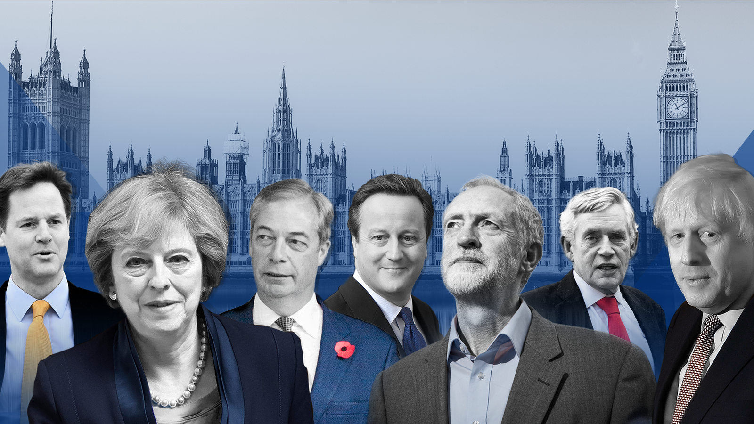



Introduction

Slide 3
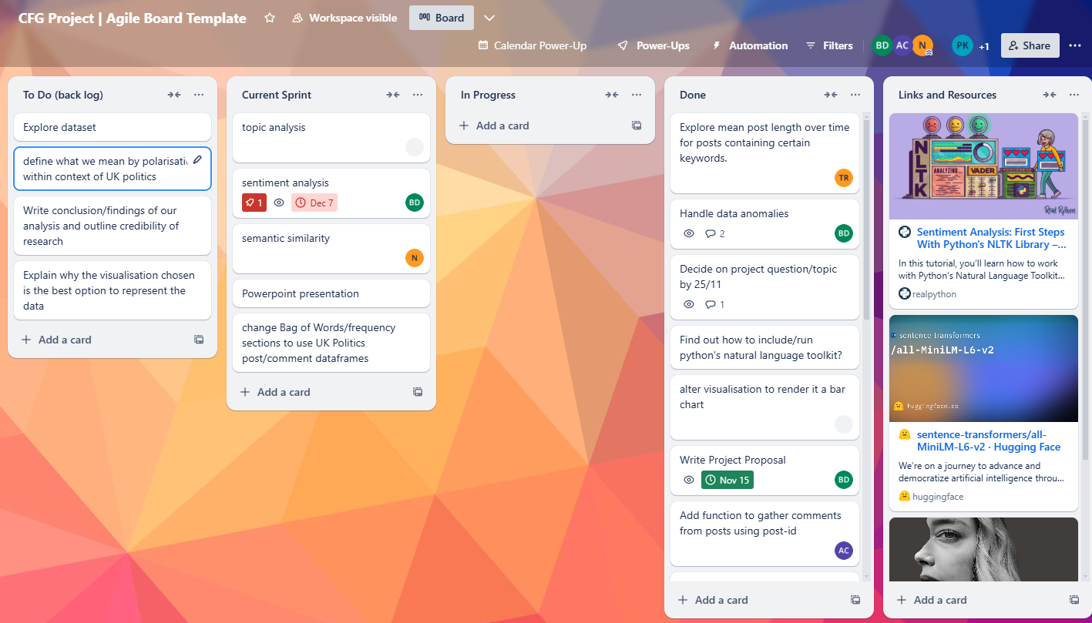



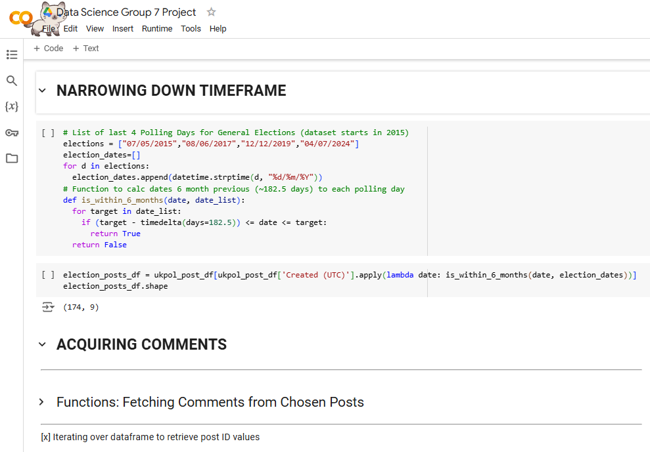
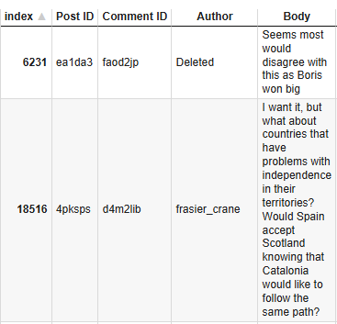
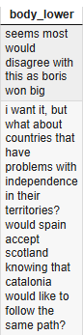
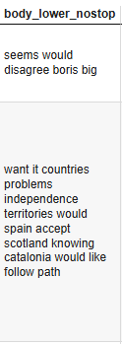
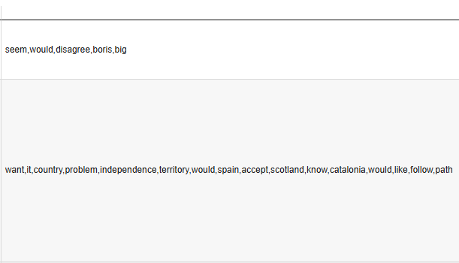
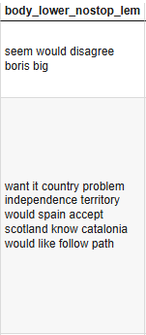

Specifications & Implementation
Collaborative Tools:
Data Wrangling
PRAW api
Issues of Scale
Text Processing

Slide 4
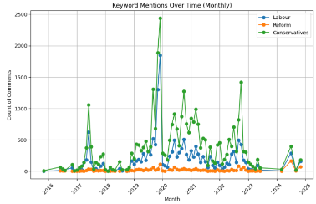
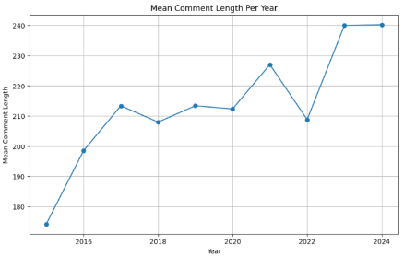
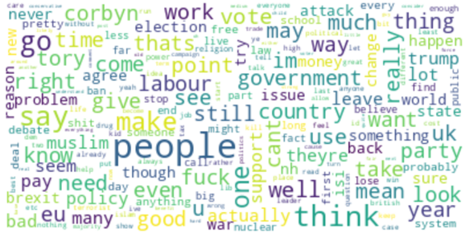
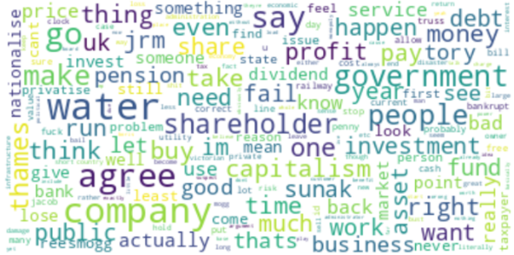
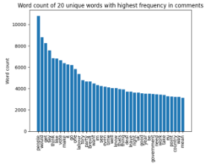
Visualisations
Bag of words analysis
Word clouds,
line graphs and bar charts

Slide 5
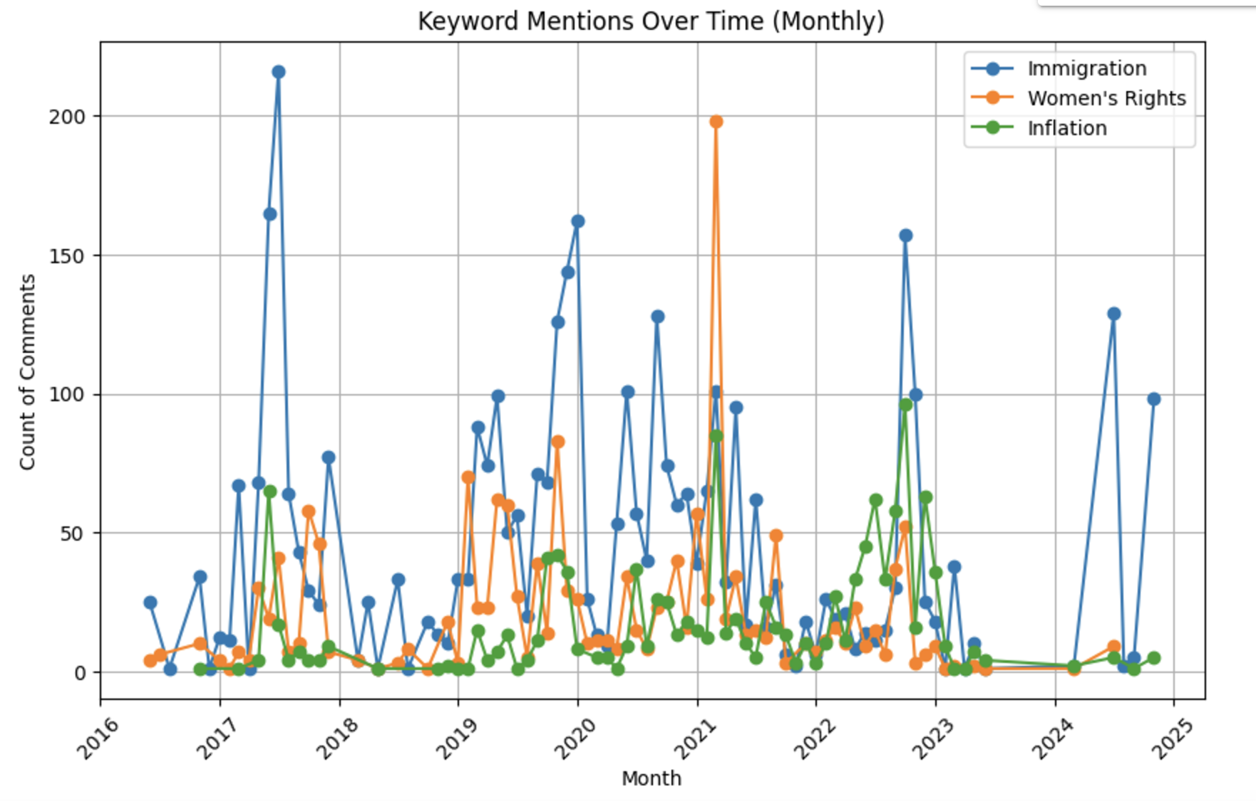

Conclusion
Immigration posts peaked during General Elections and changes in Prime Minister.

Slide 6
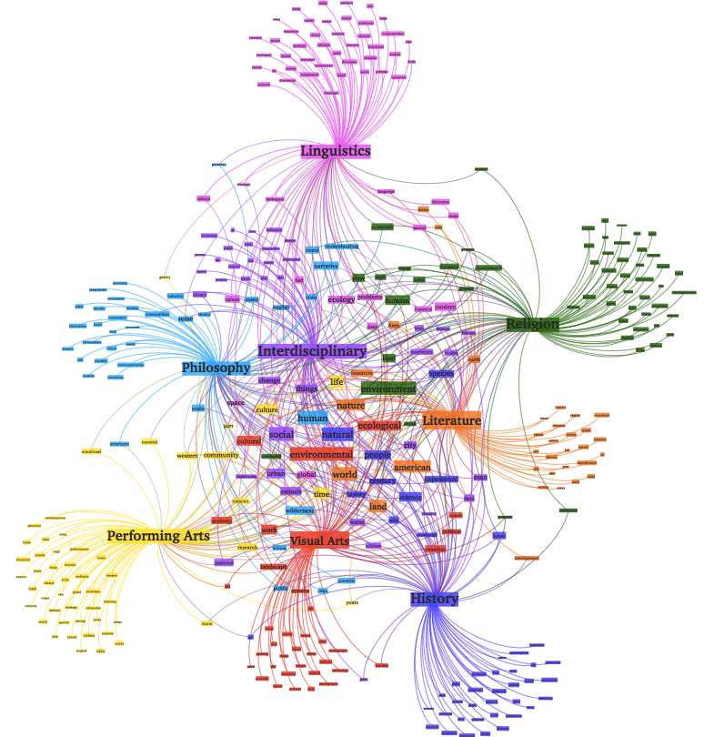


Conclusion
How would we expand on the situation?
Topic analysis
Sentiment analysis
Polarisation

